Slide 1



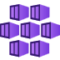
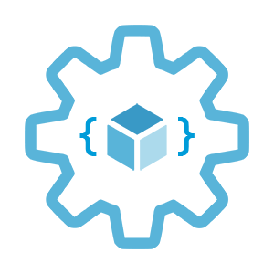

Monitoring options in AKS
Infrastructure as Code User Group Oslo
17.02.2022
with Evgeny Borzenin

Slide 2

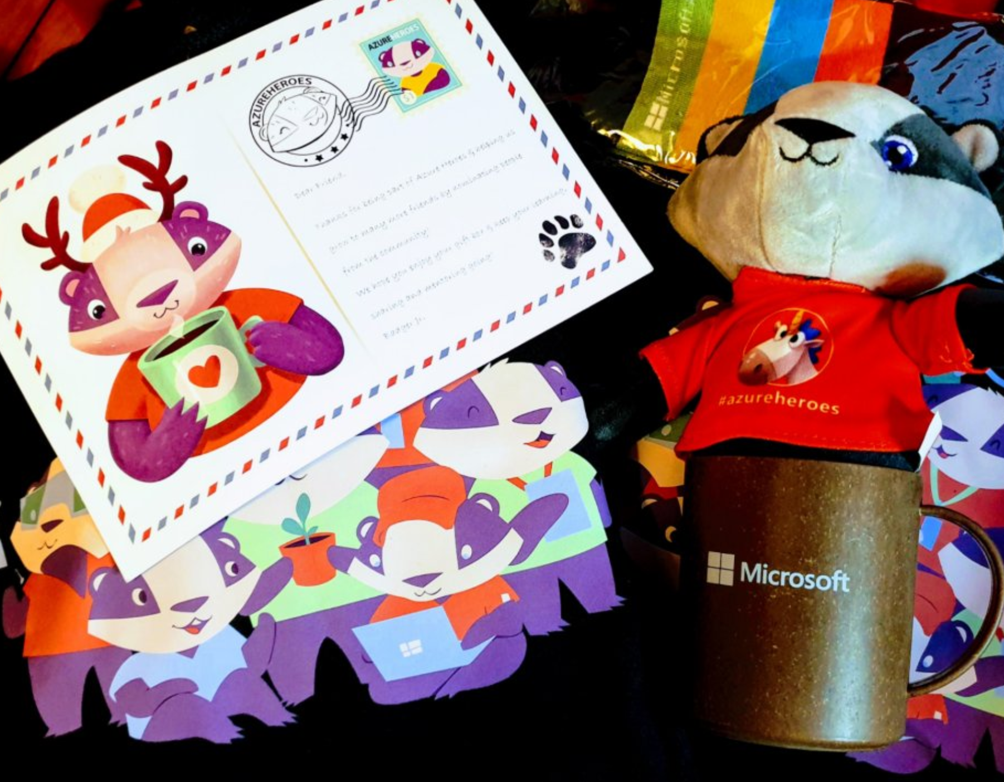
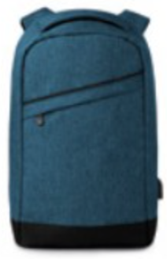


Guide on monitoring AKS using Azure Monitor: https://aka.ms/azure-aks
Get your next Learner digital badge of Azure Heroes program https://aka.ms/azure-heroes-badge
Win a cool Microsoft backpack!
Don’t forget to add Microsoft Azure skill to your LinkedIn account to stay connected with a developer community
+ Microsoft Azure
We post the latest announces about free events for the developers in Norway on our official Twitter account
@MSDevNo
Notes:
Our usergroup partners with Microsoft Norway
On this slide you’ll find a link to the documentation about AKS monitoring, and a link to claim your digital badge of the Azure Heroes program.
Also, Microsoft Norway has a tech twitter account where they announce their own and community-driven events for the developers – please follow @MSDevNo to stay updated.
Follow https://twitter.com/msdevno to not miss the events for the developers – to learn about Azure and to gather more Azure Heroes badges!

Slide 3
Infrastructure as Code User Group roadmap
AKS workshops roadmap:
[x] AKS and Kubernetes 101
[x] Advanced AKS configuration
[x] Implement Immutable AKS Infrastructure on Azure with Bicep
[x] GitOps in AKS with Flux
[x] Scaling options for applications and clusters in AKS
[ ] Monitoring options in AKS
[ ] Azure Landing Zones 101 (Not 100% decided yet)
[ ] Service mesh in AKS with linkerd
[ ] Security in AKS
“regular” events (work in progress)

Slide 4
Workshops in your organization
Infrastructure as Code (Bicep, ARM)
AKS workshops
Azure Cloud Adaptation Framework
Workshops can be adapted for your organization use-case
List of past workshops: https://borzenin.com/workshops/
Commercial offer from Enso AS
Contact me at evgeny@enso.no if any interest

Slide 5
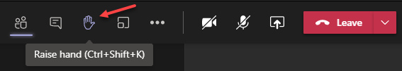
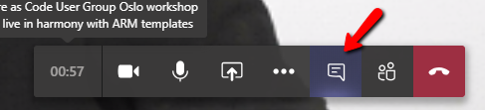
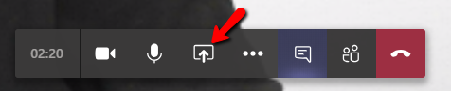
Microsoft Teams 101
Mute your mic (but don’t forget to unmute when you speak)
Feel free to use video
«Rise your hand» if you need some attention
Conversation/chat
Share screen

Slide 6
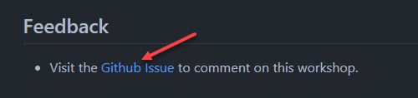
Practical information
Each lab is time-boxed (ish…)
When you done with lab, post to the Conversation channel
lab-01 (lab-02, lab-03 etc…)
Feel free to contribute to the labs content by fixing gramma, typos, wrong commands etc..
Feel free to comment on workshop main page

Slide 7
Monitoring in general

Slide 8
Monitoring
Infrastructure
Applications
Notes:
If you ask different people in your org what Monitoring means for them, you will get different perspective deneding who do you ask.
Ops, SRE guys will start talking about infra monitoring, CPU, RAM, DISK IO, Networking, Servers crashes,
Devs will talk about applications, exceptions, memory leaks,
DBA will start blame developers, that they write SQL without checking with them and that causes a table scan leading to the bad DB performance
Security will talk about firewal rules,
And Business will talk about business KPI, like number of purchases, number of new customers and new

Slide 9
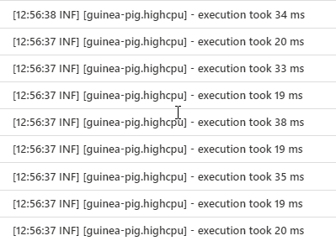
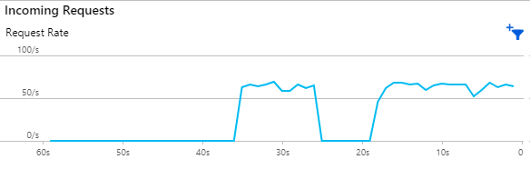
Monitoring
Logs
Metrics
Notes:
A log message is a system generated set of data when an event has happened to describe the event. In a log message is the log data. Log data are the details about the event such as a resource that was accessed, who accessed it, and the time. Each event in a system is going to have different sets of data in the message.
While logs are about a specific event, metrics are a measurement at a point in time for the system.
This unit of measure can have the value, timestamp, and identifier of what that value applies to (like a source or a tag).
Logs may be collected any time an event takes place, but metrics are typically collected at fixed-time intervals.
Sometimes metrics are implemented as logs with numeric values

Slide 10

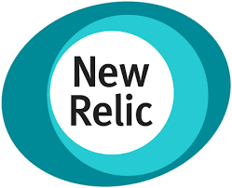


Monitoring
Logs
Metrics
Notes:
Quite often it’s different systems used to collect, vizualize and analyze logs and metrics

Slide 11
Monitoring
Monitoring platform
Monitors infra and apps 24/7
Alerts during outages
Reports for analysis

Slide 12
Monitoring options in AKS

Slide 13
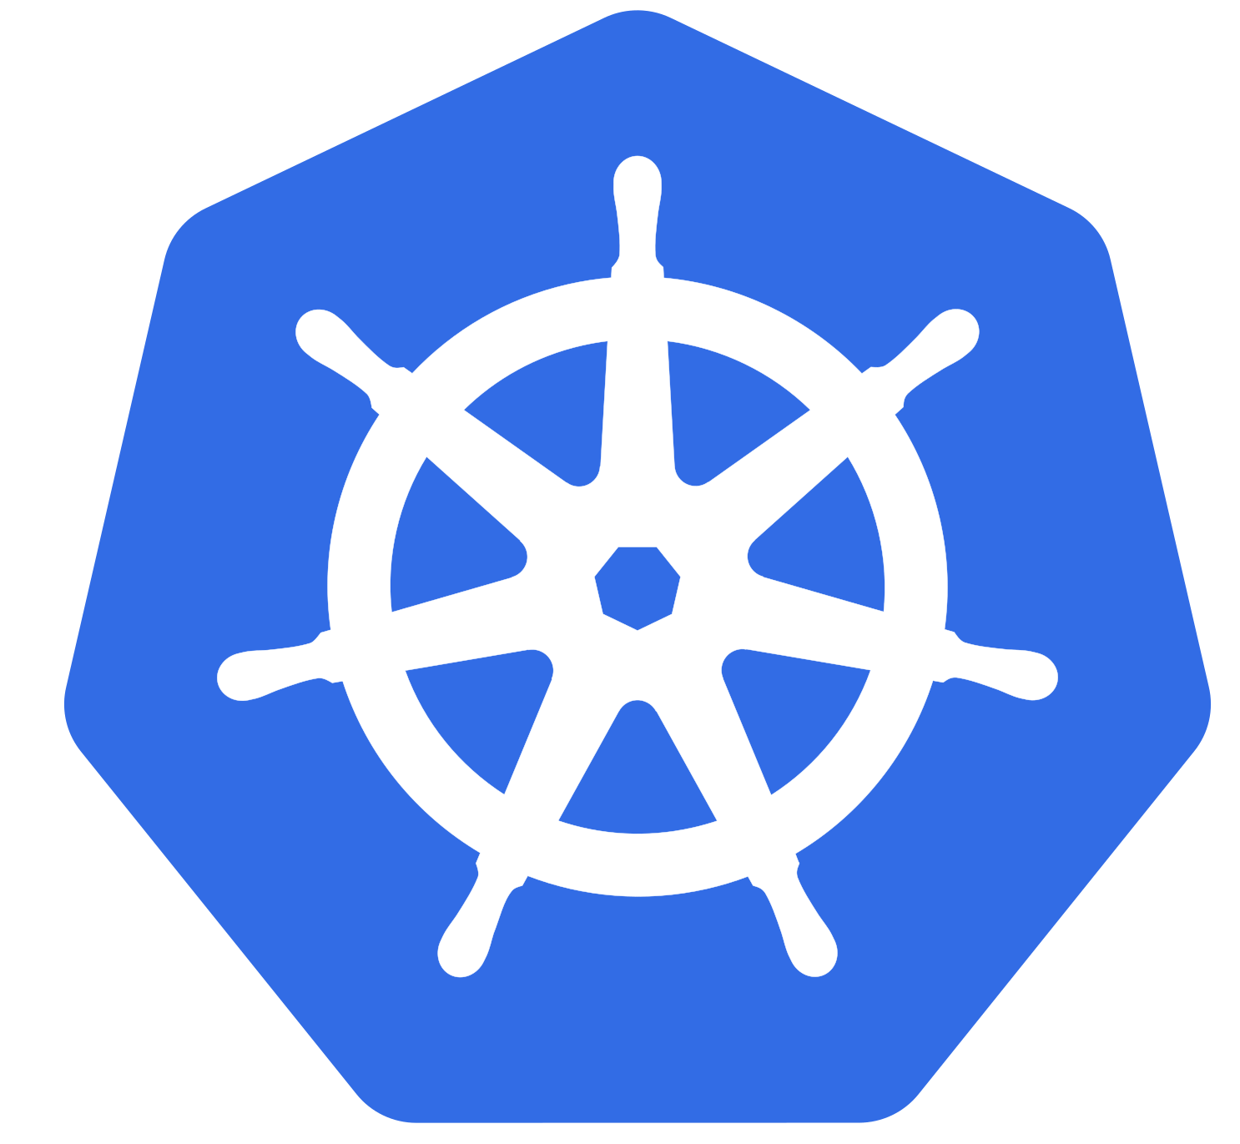
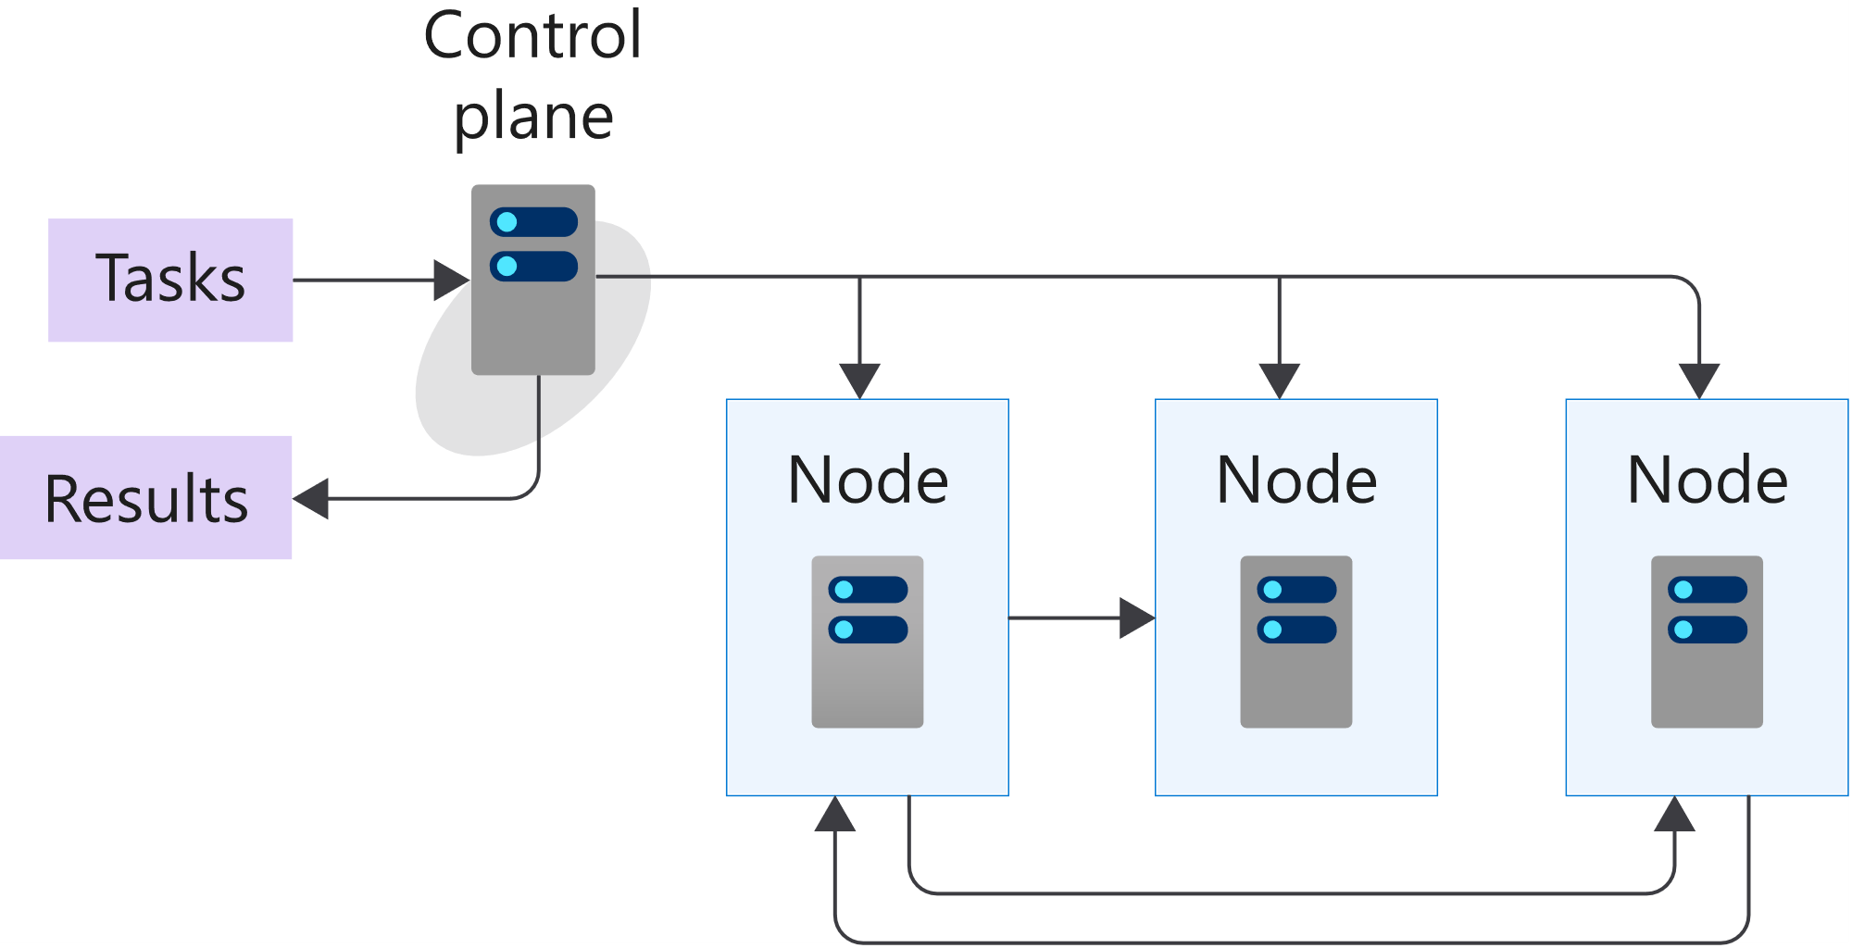
K8s 101: Cluster and Nodes
Azure-managed
Nodes are machines (VM) in your cluster
Nodes are where your workloads run
Nodes can come and go
Customer-managed
Image from https://docs.microsoft.com/en-us/learn/modules/intro-to-kubernetes/3-how-kubernetes-works
Notes:
A cluster is a set of computers that you configure to work together and view as a single system. The computers configured in the cluster will typically do different type of tasks. For example, they'll host websites, APIs, or run compute-intensive batches.
A cluster uses centralized software that's responsible for scheduling and controlling these tasks. The computers in a cluster that run the tasks are called nodes, and the computers that run the scheduling software are called control planes.
A node in a Kubernetes cluster is where your compute workloads run.
Each node communicates with the control plane via the API server to inform it about state changes on the node.

Slide 14
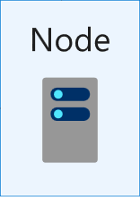
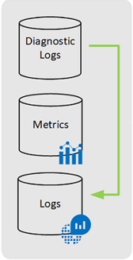
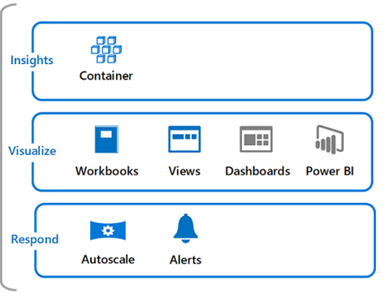
Container insights overview
omsagent
ConfigMap
omsagent
Image is taken from: https://docs.microsoft.com/en-us/azure/azure-monitor/containers/container-insights-overview?WT.mc_id=AZ-MVP-5003837
Notes:
Container insights is a feature designed to monitor the performance of container workloads deployed to AKS:
Container insights gives you performance visibility by collecting memory and processor metrics from controllers, nodes, and containers.
Container logs are also collected.
Container insights supports clusters running the Linux and Windows Server 2019 operating system.
By default, Container insights is disabled and you need to enable it (portal, cli, powershell, ARM, Bicep etc)
When CI enabled, Metrics and logs are automatically collected for you through a containerized version of the Log Analytics agent aka omsagent.
Metrics are written to the metrics store and log data is written to the logs store associated with your Log Analytics workspace.

Slide 15
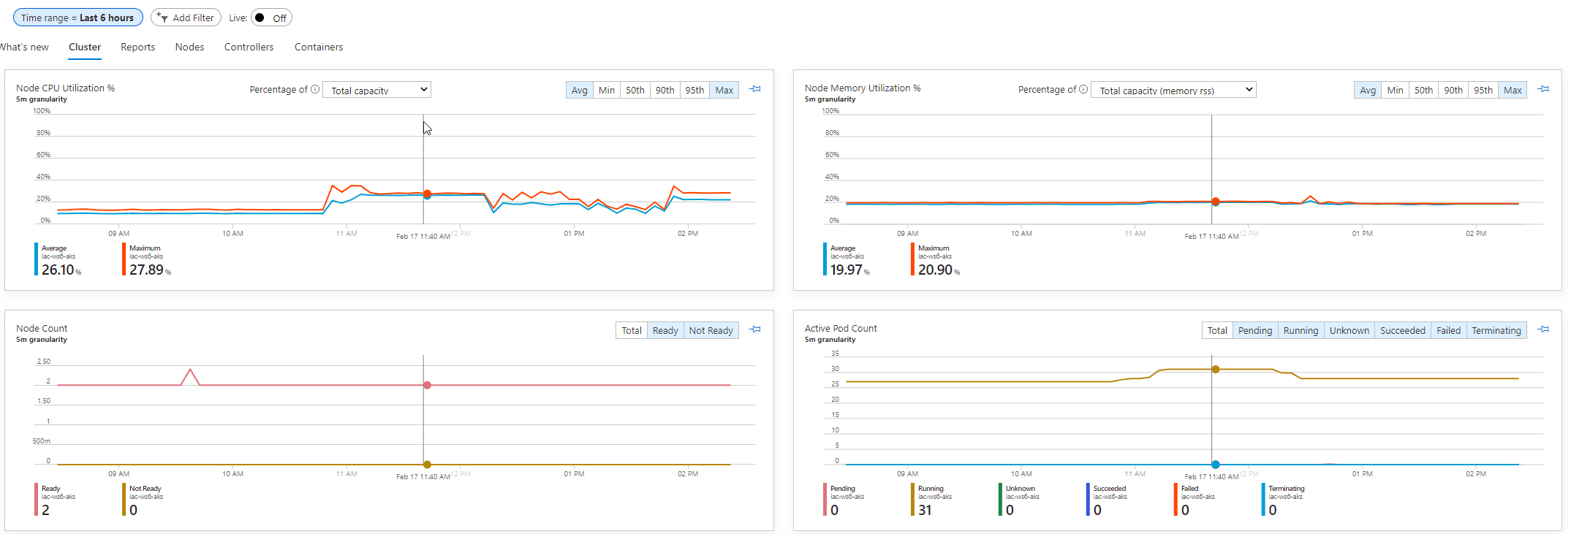
Container insights overview

Slide 16
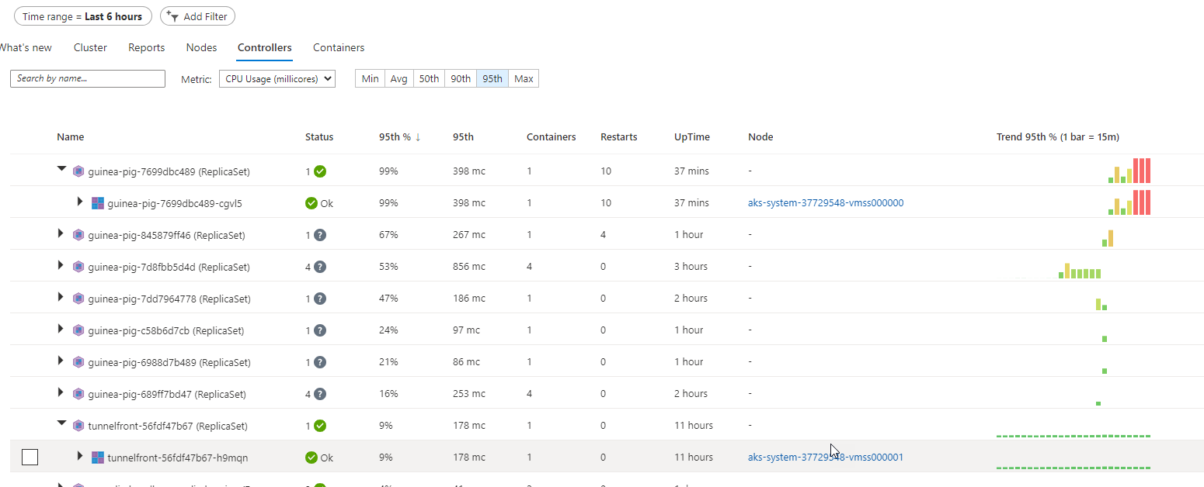
Container insights overview

Slide 17
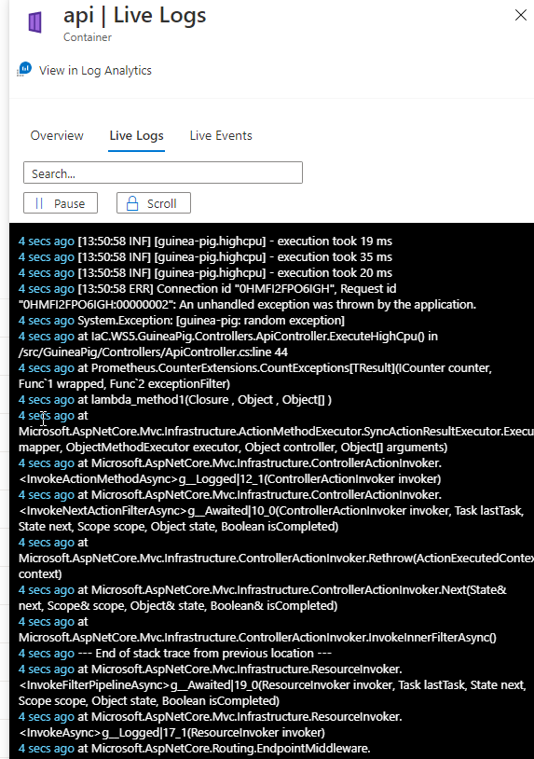
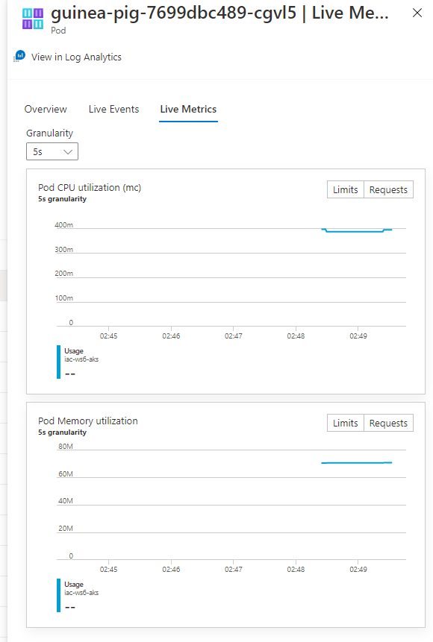
Container insights overview

Slide 18

What if monitoring platform already exists?

Slide 19
Splunk
hec
hec

Slide 20
Dynatrace
agent
dtagent

Slide 21
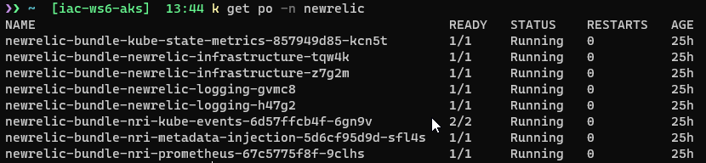
NewRelic
agent
dtagent

Slide 22
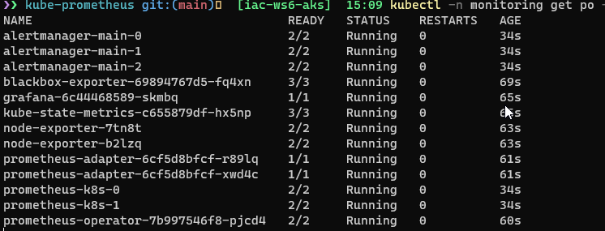
Prometheus + Grafana – in cluster
prometehus
grafana
alertmanager
Use port-forward

Slide 23
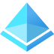

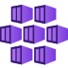

Securely expose Grafana with AGW + AAD
AAD
https://grafana.iac-labs.no/
AKS
AGW
Grafana service
or via ingress controler
grafana
backend
Http Listener

Slide 24
Prometheus in cluster + Grafana in cloud
Securely expose Thanos query endpoint with mTLS via Azure Application Gateway
https://foobar.grafana.net
Signup with SAML
AAD
https://prometheus.foobar.no/
AKS
AGW
Grafana cloud
Http Listener
Prometheus Data Source
with TLS client auth
prometheus
prometheus
backend
SSL policy
Dashboards
Client cert
Self-signed client certificate
CN= prometheus.foobar.no

Slide 25
Lab-01, 02, 03

Slide 26


Slide 27
Lab-04, 05, 06

Slide 29
Lab-07, 08

